Slide 1


The Airbnb Enigma: Navigating Urban Housing Uncertainty
This presentation explores the complex impact of Airbnb on urban housing markets and community sentiment.
Om Rane

Slide 2
01
The Airbnb Enigma
Airbnb's rapid expansion has reshaped urban housing, sparking vital community debates. Our study dives into these concerns, analyzing forum discussions to gauge uncertainty and emotional tones.
We analyze community forum discussions to gauge uncertainty levels and emotional tones surrounding Airbnb.
Our research focuses on four major U.S. cities: Boston, New Orleans, Los Angeles, and Chicago.
We employ NLP techniques to analyze sentiment and identify expressions of uncertainty in online forum data.
We'll reveal how uncertainty varies across cities and over time, uncovering valuable insights for policymakers.

Slide 3
02
Uncertain Times
To quantify uncertainty, we scraped data from Airbnb community forums from October 2014 to February 2020. Our methodology involved advanced natural language processing.
Data was collected using Python, focusing on posts from a five-year period.
Sentiment was categorized into five levels, and modality as highly certain, moderately certain, or uncertain.
We identified over 25 hedging expressions, such as 'might' or 'hopefully', to flag uncertainty.
Key libraries included undetected_chromedriver, BeautifulSoup, spaCy, and matplotlib for data visualization.
TextBlob was used to score sentiment polarity, ranging from -1 (negative) to +1 (positive).
This multi-faceted approach allowed for a nuanced understanding of public discourse.

Slide 4
03
Data Collection Challenges & Solutions
Dynamic Content
Forum posts load with JavaScript
Used undetected_chromedriver + scroll loading
Inconsistent Dates
Corrupted/missing date strings
Regex cleaning and custom format parsing
Missing Metadata
Replies lacked full user/reply metadata
Fallback checks and "Unknown" assignments
Duplicates
Same post appeared multiple times
Python set() for unique post text filtering
Irrelevant Dates
Posts outside Oct 2014–Feb 2020 range
Strict datetime.strptime() filtering
Rate-Limiting
Fast requests triggered blocking
Introduced sleep() delays and slow scroll

Slide 5
04
Boston & New Orleans: A Closer Look
Boston Forum Insights
New Orleans Forum Insights
Out of 334 total posts, 114 (34.13%) contained expressions of uncertainty. A typical example:
With 103 total posts, 36 (34.95%) exhibited uncertainty. One user commented:
"I think the city might change regulations soon."
"I just received a letter. Not sure what it means yet."
Analysis revealed a predominantly neutral sentiment regarding Airbnb regulations, reflecting ongoing ambiguity among users.
Similar to Boston, New Orleans also displayed a largely neutral sentiment, pointing to a lack of clear information.
Both cities demonstrate comparable levels of uncertainty, suggesting a widespread lack of clarity surrounding Airbnb policies and their future implications.

Slide 6
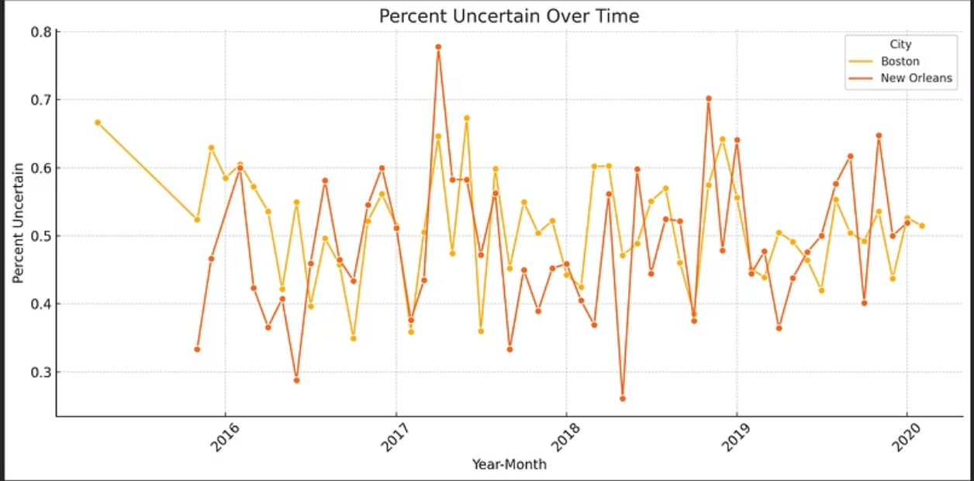
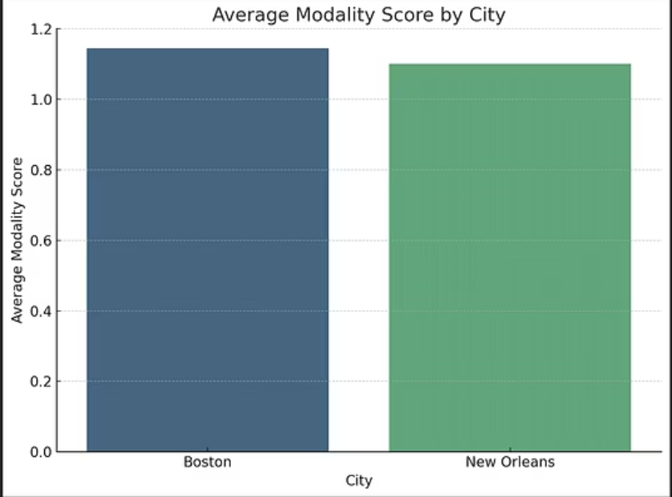
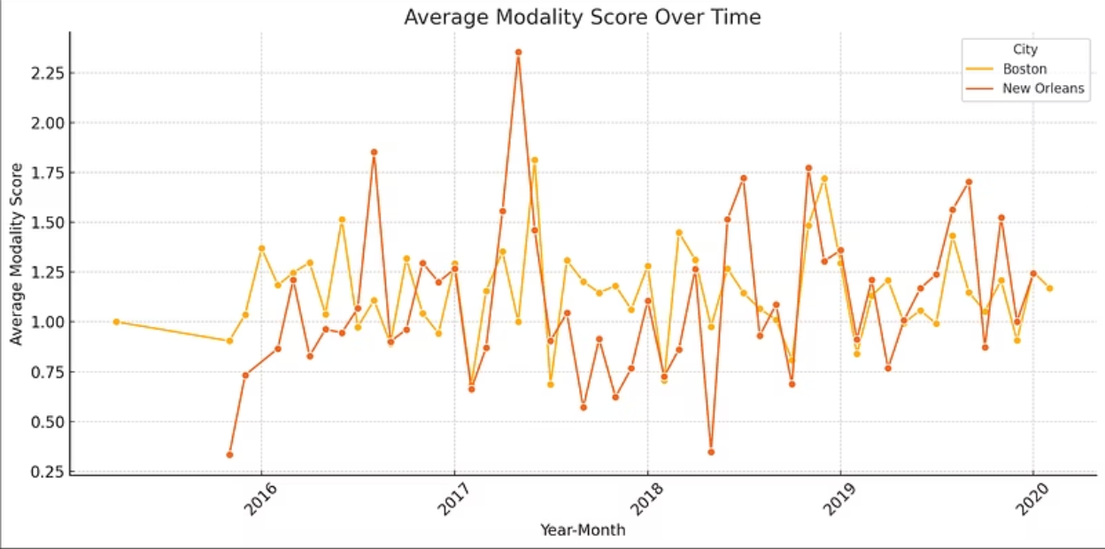
05
Uncertainty Trends: Boston & New Orleans
Visualizing sentiment and uncertainty over time in Boston and New Orleans community forums.

Slide 7
06
Los Angeles & Chicago: The West Coast and Midwest Perspectives
Los Angeles: High Uncertainty
Chicago: Similar Levels of Confusion
Out of 168 total posts, a significant 85 (50.6%) expressed uncertainty. This elevated percentage underscores a pronounced lack of clarity among forum participants regarding Airbnb policies in the city.
Chicago's forums mirrored Los Angeles, with 119 out of 234 posts (50.85%) indicating uncertainty. This striking similarity across both major cities suggests a widespread challenge in understanding and navigating Airbnb regulations.
The high uncertainty in Los Angeles calls for more transparent and easily accessible regulatory information to assist hosts and residents.
Future studies could explore the specific drivers of this high uncertainty, such as complex municipal ordinances or inconsistent enforcement.

Slide 8
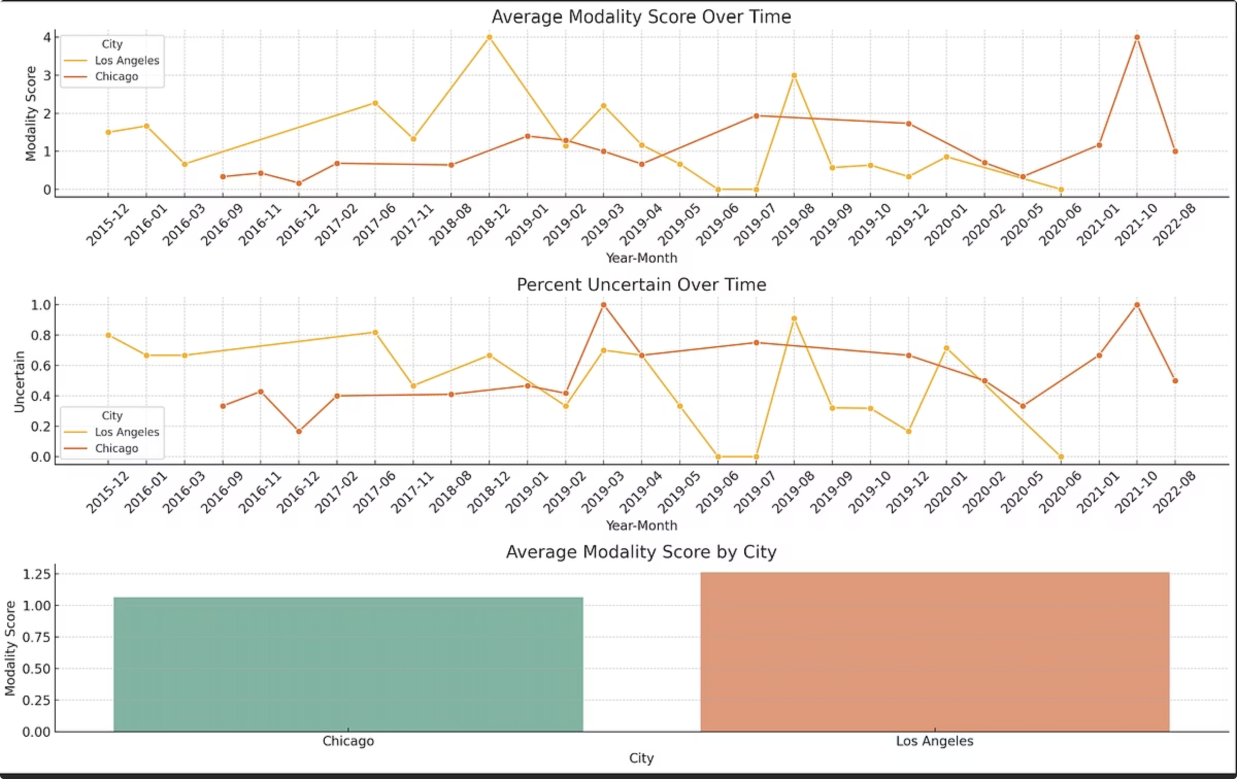
07
Uncertainty Trends: Los Angeles & Chicago
This chart illustrates the sentiment polarity and uncertainty levels found in Airbnb community forums for Los Angeles and Chicago.

Slide 9




08
Actionable Recommendations
Based on findings, following recommendations for urban planning researchers and policymakers to mitigate uncertainty and improve community relations:
Clarity in Regulations
Host Education
Publish clear, city-specific short-term rental regulations and host regular public Q&A sessions to address concerns directly.
Implement a system to tag listings as compliant or pending compliance and launch educational campaigns to inform hosts about local laws and their responsibilities.
Advanced Research
Real-time Monitoring
Expand future studies to include more cities globally and utilize advanced NLP techniques for deeper emotion detection and topic modeling.
Develop real-time NLP dashboards to continuously monitor public sentiment and reactions to new policies, allowing for agile policy adjustments.

Slide 10

09
Thank You!
.

